Slide 1
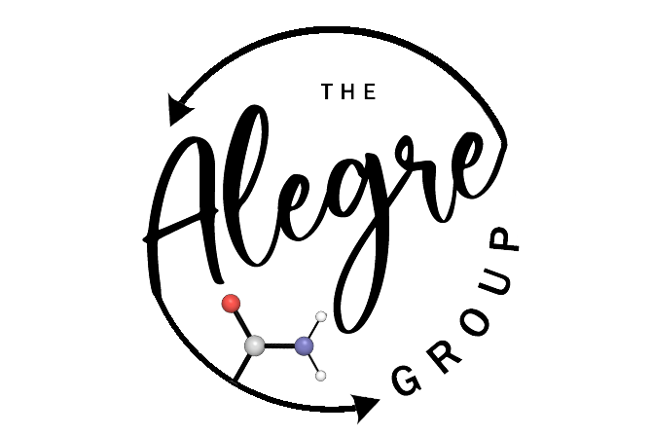

Summer School 2025
Digital chemical reactions
Introduction to SMILES strings, SMARTS strings, using RDKit to set up digital reactions and automating reactions with multiple substrates
June 9, 2025
Dr. Susana García-Abellán

Slide 2






What is Machine Learning?
Way to model data
Data
Look for patterns in the data
Create a predictive model
Useful predictions based on those patterns
In chemistry, what is our data?!
- Trainable model: Predictions to optimize the model
- Data in → Patterns learned → Predictions out
- Model: Trained mathematical function that maps inputs to outputs

Slide 3
Strings and vectors
Molecule → String → Vector
VECTOR
Data
Descriptors are numerical values that capture different aspects of a molecule.
Descriptors can be generated in different ways:
Experimental data (boiling point, solubilities or spectroscopic values).
Cheminformatics tools like RDKit (molecular weight or number of H bond donors).
Computational data (HOMO-LUMO gaps, charges, or dipole moments).
- These numbers can then be used as input for machine learning models.
- For each molecule, x number of descriptors generates one vector of x dimensions.
Data representations:
SMILES
Fingerprints
Graphs
3D representations
STRING

Slide 4
SMILES
SMILES: Simplified Molecular Input Line Entry System
Data
There is a specification that encodes molecular structures into a line of text using short ASCII strings. These strings provide a compact and human-readable way to represent molecules, and are widely used in cheminformatics for storing, sharing, and processing chemical data.
Data representations:
Why are SMILES important?
They provide a standard format to represent molecules digitally.
They can be easily parsed by computers and are supported by many cheminformatics libraries (e.g., RDKit).
They enable descriptor generation and molecular modeling, which you'll explore in depth in next sessions.
SMILES
Fingerprints
Graphs
3D representations
There are 6 generic SMILES encoding rules, corresponding to specifications of: 1) Atoms, 2) Bonds, 3) Branches, 4) Ring closures, 5) Disconnections, and 6) Isomerism.

Slide 5
Basic SMILES rules
1. Atom specifications
The SMILES atom specification sublanguage represents the atomic properties: element identity, formal charge, and implicit hydrogen count.
Elements in the “organic subset” B, C, N, O, P, S, F, Cl, Br, and I may be written without brackets if the number of attached hydrogens conforms to the lowest normal valence consistent with explicit bonds. “Lowest normal valences” are B (3), C (4), N (3, 5), O (2), P (3, 5), S (2, 4, 6), and halogens (1).
Methane: C [CH4] CH4
Ethane: CC [CH3][CH3] CH3CH3
Ethanol: CCO [CH3][CH2][OH] CH3CH2OH
2-Chloroethanol: ClCCO
Atoms in aromatic rings are specified by lower case letters. Aliphatic carbon is represented by capital letter C, aromatic carbon by lower case c.
benzene: c1ccccc1
The symbol ‘*’ is treated by SMILES as a valid atomic symbol meaning “unspecified atomic number” and is represented as an atom of atomic number zero.

Slide 6
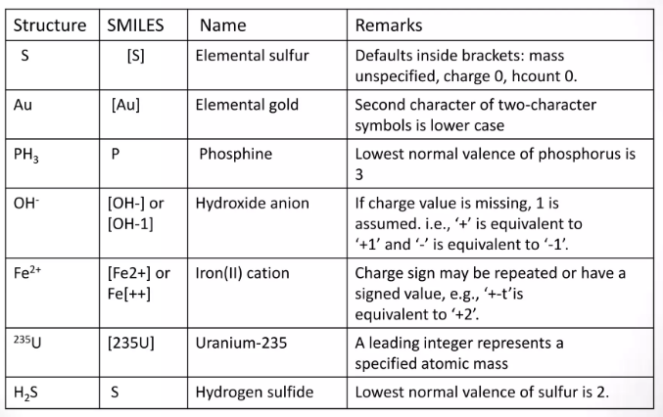
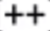
Basic SMILES rules
1. Atom specifications

Slide 7
Basic SMILES rules
2. Bond specifications
Single, double, triple, and aromatic bonds are represented in SMILES by the symbols -, =, #, and :, respectively. Adjacent atoms without an intervening symbol are connected by a valence-dictated bond (typically a single or aromatic bond). “-“ (single) and “:” (aromatic) bond symbols may always be omitted on input.
CO₂: O=C=O
Ethanol: C-C-O CCO
Acetonitrile: N#CC
benzene: c:1c:c:c:c:c:1 c1ccccc1
There is no “preferred” or “correct” ordering in SMILES.
Ethanol: OCC CCO
SMILES grammar is such that it may be canonicalized, i.e., among all possible valid SMILES for a given molecule or reaction, there is a single, canonical (unique).
https://www.leskoff.com/s01812-0

Slide 8
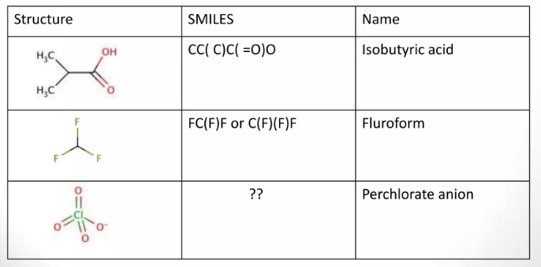
Basic SMILES rules
3. Branching
Branches are specified in SMILES by enclosing them in parentheses, which may be nested (()) or stacked ()().
First three rules (atoms, bond and branching) allow specification of any non-cycling molecule.
Notes:
O=Cl(=O)([O-])=O

Slide 9
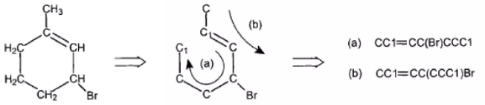
Basic SMILES rules
4. Ring specifications
Pick one bond in each ring and numbering them in any order.
Break the numbered bonds, appending the bond number to the atoms on the ends of the bonds so broken.
Note that this leaves an acyclic structure which can be always be specified using the three rules for specifying atoms, bonds, and branching.

Slide 10
Basic SMILES rules
5. Disconnections
The ‘.’ is used in SMILES to represent disconnections, the atoms on either side of the dot are explicitly not bonded to each other. The order in which ions or ligands are listed is arbitrary.
Sodium phenoxide: [Na+].[O-]c1ccccc1 c1cc([O-].[Na+])ccc1
6. Isomerism
SMILES provides for four types of specification which are so important to the molecular model that they are included even though they are outside the valence model. They are: isotopism, orientation about double bound, stereo specification, and (for reactions) reactant-product atom mapping. These are collectively known as “isomeric SMILES”.
https://www.daylight.com/meetings/summerschool98/course/dave/smiles-isomers.html

Slide 11
SMILES
SMILES: Simplified Molecular Input Line Entry System
Data
- Information about SMILES notation:
https://www.daylight.com/dayhtml/doc/theory/theory.smiles.html
- Online SMILES generators:
Data representations:
https://cdb.ics.uci.edu/cgibin/Smi2DepictWeb.py
SMILES
- Online canonicalized SMILES generators:
Fingerprints
https://www.leskoff.com/s01812-0
Graphs
3D representations

Slide 12
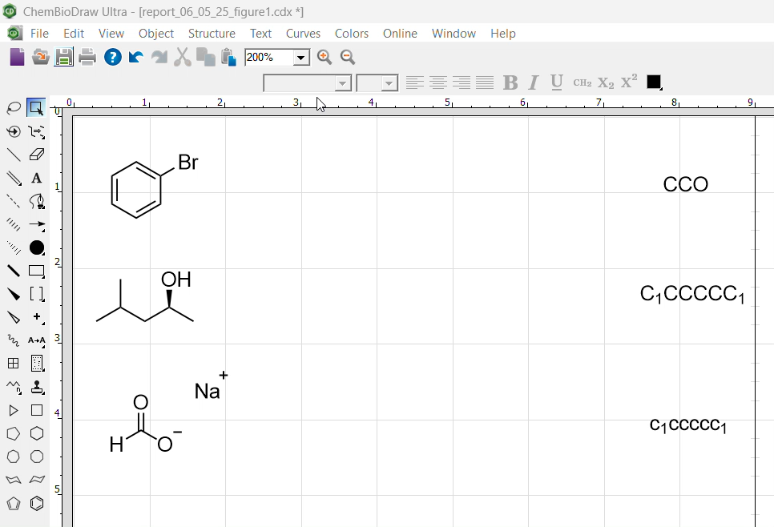
SMILES
SMILES: Simplified Molecular Input Line Entry System
Data
- A text-based format (string) to describe molecular structures.
SMILES | Name
CCO | ethanol
C1CCCCC1 | ciclohexane
c1ccccc1 | benzene
Data representations:
SMILES
Fingerprints
- Information about SMILES notation:
Graphs
https://www.daylight.com/dayhtml/doc/theory/theory.smiles.html
3D representations
- Online SMILES generators:
https://cdb.ics.uci.edu/cgibin/Smi2DepictWeb.py

Slide 13
SMARTS
SMARTS - A Language for Describing Molecular Patterns
SMARTS (SMILES Arbitrary Target Specification) is a language used to define molecular substructures for searching chemical databases.
It extends SMILES by allowing logical operators and advanced atom/bond symbols, enabling flexible and meaningful queries.
Atomic Primitives
Bond Primitives
Logical Operators
Recursive SMARTS
Component-level grouping of SMARTS
Reaction Queries
https://www.daylight.com/dayhtml/doc/theory/theory.smarts.html

Slide 14
SMARTS
1. Atom primitives
SMARTS provides a number of primitive symbols describing atomic properties beyond those used in SMILES (atomic symbol, charge, and isotopic specifications).
There are tables listing the atomic primitives used in SMARTS, and all SMILES atomic symbols are also legal.
https://www.daylight.com/dayhtml/doc/theory/theory.smarts.html

Slide 15
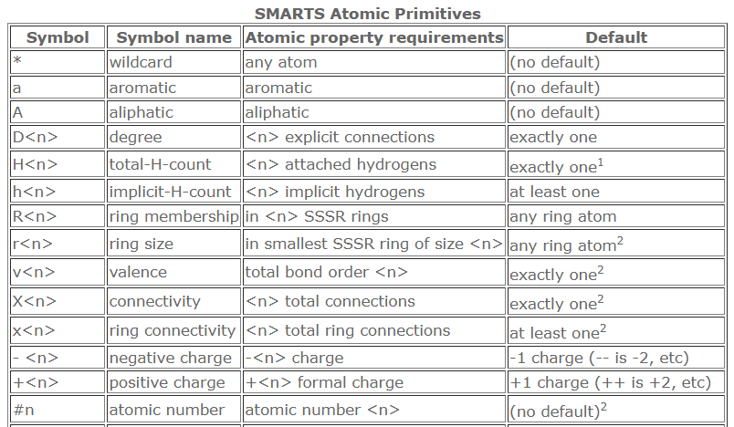
SMARTS
1. Atom primitives
SMARTS provides a number of primitive symbols describing atomic properties beyond those used in SMILES (atomic symbol, charge, and isotopic specifications).
There are tables listing the atomic primitives used in SMARTS, and all SMILES atomic symbols are also legal.
https://www.daylight.com/dayhtml/doc/theory/theory.smarts.html

Slide 16
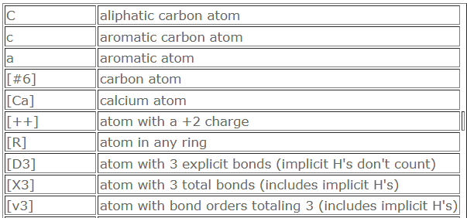
SMARTS
1. Atom primitives
SMARTS provides a number of primitive symbols describing atomic properties beyond those used in SMILES (atomic symbol, charge, and isotopic specifications).
There are tables listing the atomic primitives used in SMARTS, and all SMILES atomic symbols are also legal.
Some examples:
https://www.daylight.com/dayhtml/doc/theory/theory.smarts.html

Slide 17
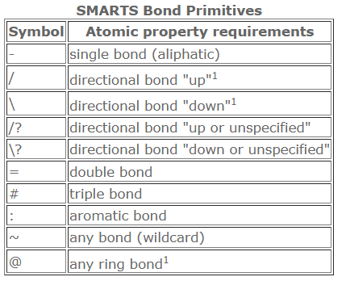
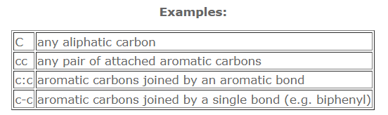
SMARTS
2. Bond primitives
Various bond symbols are available to match connections between atoms. A missing bond symbol is interpreted as "single or aromatic".
https://www.daylight.com/dayhtml/doc/theory/theory.smarts.html

Slide 18
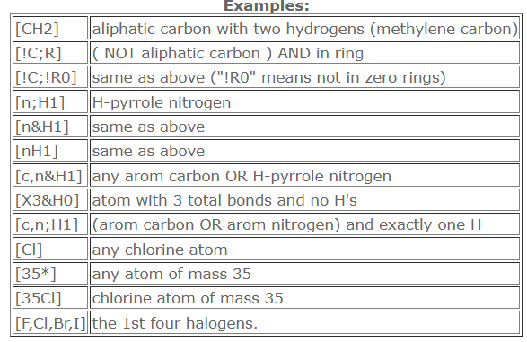
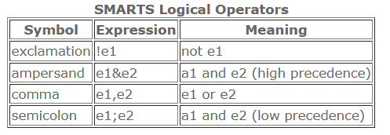
SMARTS
3. Logical Operators
Atom and bond primitive specifications may be combined to form expressions by using logical operators. In the following table, e is an atom or bond SMARTS expression (which may be a primitive). The logical operators are listed in order of decreasing precedence (high precedence operators are evaluated first).
All atomic expressions which are not simple primitives must be enclosed in brackets.
https://www.daylight.com/dayhtml/doc/theory/theory.smarts.html

Slide 19
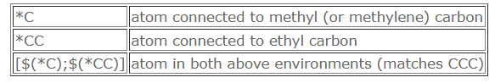
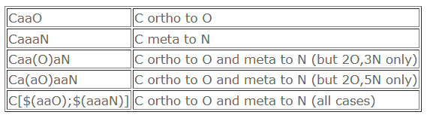
SMARTS
4. Recursive SMARTS
Any SMARTS expression may be used to define an atomic environment by writing a SMARTS starting with the atom of interest in this form: $(SMARTS)
Such definitions may be considered atomic properties. These expressions can be used in same manner as other atomic primitives (also, they can be nested). Recursive SMARTS expressions are used in the following manner:
The additional power of such expressions is illustrated by the following example which derives an expression for methyl carbons which are ortho to oxygen and meta to a nitrogen on an aromatic ring.
https://www.daylight.com/dayhtml/doc/theory/theory.smarts.html

Slide 20
SMARTS
5. Component-level grouping of SMARTS
Component-level grouping uses parentheses () and periods . to control how atoms are grouped and whether they must belong to the same or different fragments.
A period . separates components (independent fragments), while parentheses group atoms.
Examples:
(C).(C) two carbon atoms in different fragments (e.g., two separate molecules)
(C.C) two carbon atoms in the same component.
This is useful when distinguishing between intra- and inter-molecular patterns.
https://www.daylight.com/dayhtml/doc/theory/theory.smarts.html

Slide 21
SMARTS
6. Reaction Queries
https://www.daylight.com/dayhtml/doc/theory/theory.smarts.html

Slide 22
SMARTS
The importance of defining SMARTS well…
PATTERN
[NX3] [NX3;!$(NC=O)]
code_name SMILES
acetamide CC(=O)N
acetonitrile CC#N
ethylamine CCN
1. [ ... ] This denotes an atom expression. It matches a single atom that satisfies the conditions inside the brackets.
2. N This specifies the element, nitrogen (N).
3. X3 This means the nitrogen has a valence of 3 (i.e., it forms three bonds, including implicit hydrogens).
4. ; This is an AND operator within the same atom. The nitrogen must match both X3 and the next condition.
5. ! This is a logical NOT operator. It negates the pattern that follows.
6. $(NC=O) This is a recursive SMARTS pattern. It matches a substructure centered on the atom being described (N). NC=O describes a nitrogen single-bonded to a carbon (N-C) and that carbon double-bonded to an oxygen (C=O).

Slide 23
SMARTS
6. Reaction Queries
SMARTS supports reaction queries using the syntax: Reactants > Agents > Products
This format is used to describe chemical reactions, where:
Reactants are matched substructures.
Agents (e.g., solvents, catalysts) are optional. Reactants > > Products
Products define the outcome.
Atom mapping (e.g., [C:1]) is used to identify which atoms in the reactants correspond to those in the products. The numbers (:1, :2, etc.) indicate atom identities across the reaction, ensuring proper transformation tracking. Atom mapping numbers must be unique and consistent.
Example:
[N:1]=[C:2]>>[N:1]-[C:2]
Matches a reaction that reduces a nitrogen double bond to a single bond.
https://www.daylight.com/dayhtml/doc/theory/theory.smarts.html

Slide 24
Digital reactions
Simple esterification reaction: carboxylic acid + alcohol -> ester
smarts_reaction = "[C:1](=O)[O:2].[O:3][C:4]>>[C:1](=O)[O:3][C:4].[O:2]"
Reactant 1
Reactant 2
Product 1
Product 2
rxn = rdChemReactions.ReactionFromSmarts(smarts_reaction)
acid = Chem.MolFromSmiles("CC(=O)O")
alcohol = Chem.MolFromSmiles("CCO")
products = rxn.RunReactants((acid, alcohol))
acetic acid
ethanol

Slide 25
Digital reactions
Digital Reactions from a CSV (Automated Reaction Workflow)
smarts_reaction = "[C:1](=O)[O:2].[O:3][C:4]>>[C:1](=O)[O:3][C:4].[O:2]"
Reactant 1
Reactant 2
Product 1
Product 2
rxn = rdChemReactions.ReactionFromSmarts(smarts_reaction)
acid = Chem.MolFromSmiles("CC(=O)O")
alcohol = Chem.MolFromSmiles("CCO")
products = rxn.RunReactants((acid, alcohol))
list of acids
list of alcohols
acetic acid
ethanol
for loop, to have all combinations

Slide 26
Digital reactions
Reaction: ketone → enol
smarts_reaction = "[C:0][C:1](=O)[C:2]>>[C:0][C:1](O)(=[C:2])”
Reactant 1
Product 1
rxn = rdChemReactions.ReactionFromSmarts(smarts_reaction)

Slide 27
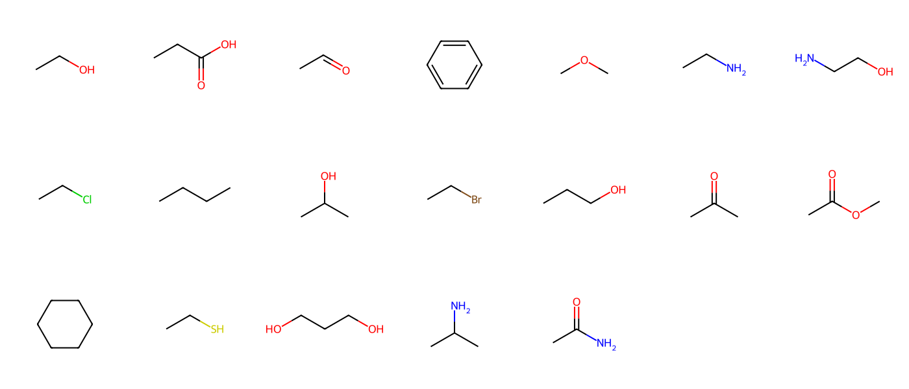
Digital reactions
Reaction: Replace ketone with alkene
smarts_reaction = "[#6:1][C:2](=O)[#6:3]>>[#6:1][C:2]=[C:3]"
Reactant 1
Product 1

Slide 28
Summer School 2025
Digital chemical reactions
Introduction to SMILES strings, SMARTS strings, using RDKit to set up digital reactions and automating reactions with multiple substrates
June 9, 2025
Dr. Susana García-Abellán

